Slide 1
Minecraft In The Math Classroom

Slide 2
Minecraft In The Math Classroom
Presentation Line Up
My Inspiration
My Journey
Why I Use Minecraft as a Tool
Minecraft In My Math Classroom
Genius Hour
Science Project
Other Classes
Coding
Resources
Who to Follow / Hashtags
What Education/Research Is Saying
What Students Are Saying
Break Out
Build Battle
Wrap Up

Slide 3
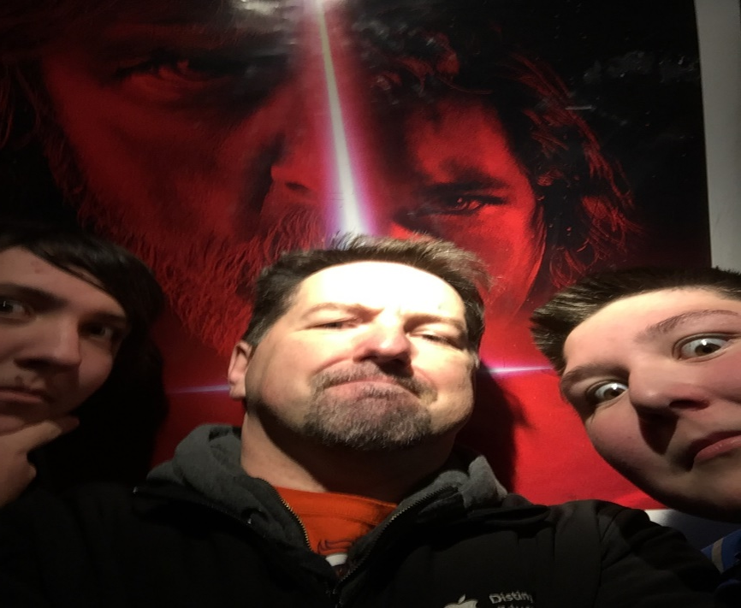
Minecraft In The Math Classroom
My Inspiration

Slide 4
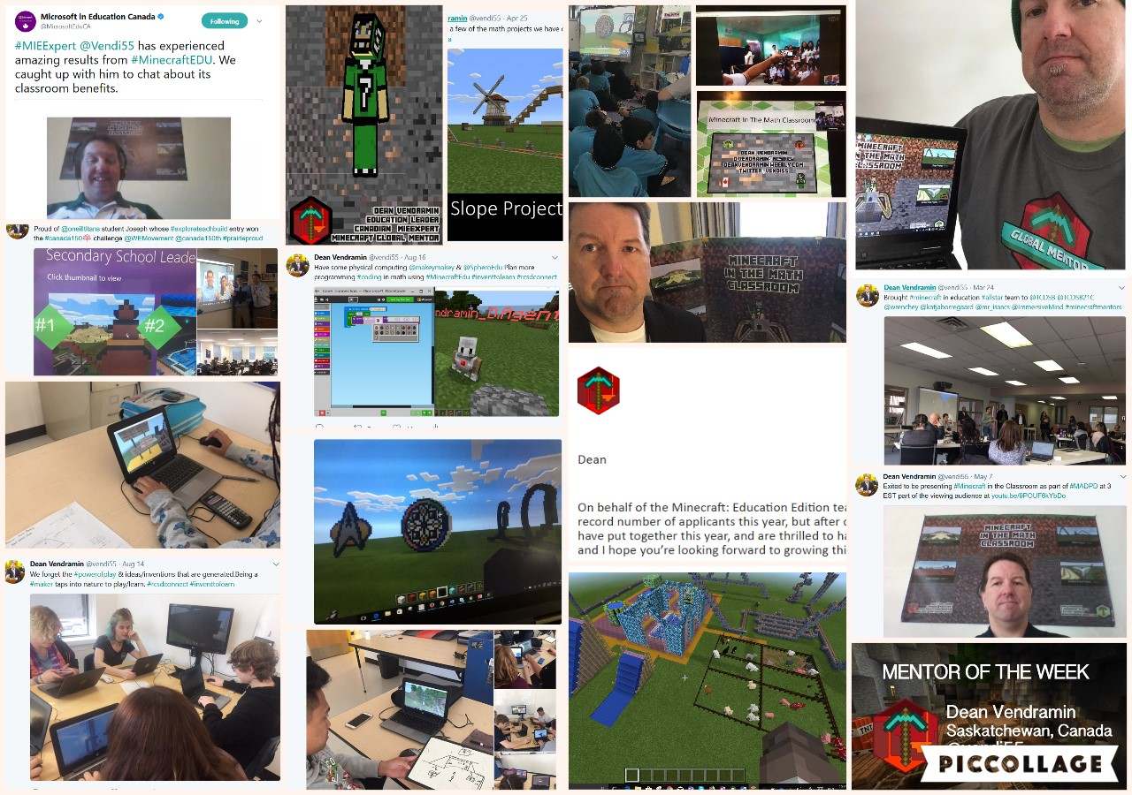
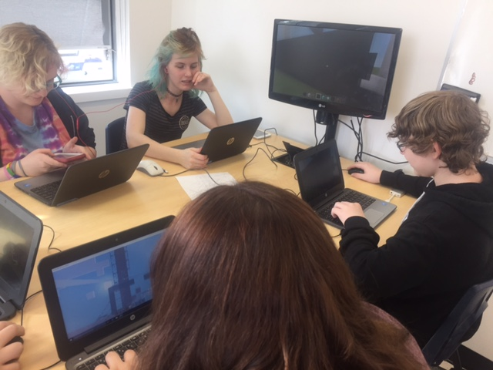
Minecraft In The Math Classroom
My Journey

Slide 5
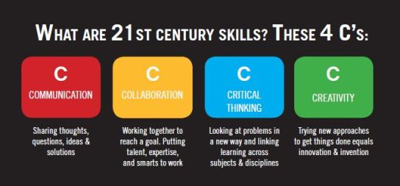
Minecraft In The Math Classroom
21st Century Skills

Slide 6
Minecraft In The Math Classroom
SAMR

Slide 7
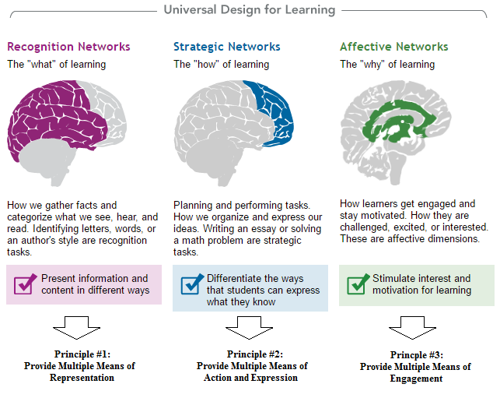
Minecraft In The Math Classroom
Universal Design for Learning

Slide 8
Minecraft In The Math Classroom
How I Use Minecraft In The Math Classroom

Slide 9
Minecraft In The Math Classroom
How I Use Minecraft In The Math Classroom – Amusement Park
Rollercoaster – Slope
Water Park – Surface Area & Volume
Water Slides – Scale/Trig
Attraction & Path - Scale

Slide 10
Minecraft In The Math Classroom
How I Use Minecraft In The Math Classroom – Grade 9 Math Concepts
Surface Area
Scale
Symmetry
Polynomials

Slide 11
Minecraft In The Math Classroom
How I Use Minecraft In Other Classrooms
Genius Hour
Science Project
Coding
Other Subjects

Slide 12
Minecraft In The Math Classroom
How to Play
Start Your Minecraft Journey
Minecraft Tutorial
Minecraft 101
Planet Minecraft
Ask Your Students

Slide 13
Minecraft In The Math Classroom
Resources
Minecraft Education Edition
My Minecraft Resources

Slide 14
Minecraft In The Math Classroom
Who to Follow / Hash Tags
https://education.minecraft.net/community/minecraft-mentors/
https://twitter.com/BBTNB
Ben's Video / Ben’s Mentors Market
https://twitter.com/mr_isaacs
https://twitter.com/ImmersiveMind
https://twitter.com/wrenchey
https://twitter.com/katjaborregaard
https://twitter.com/MeenooRami
https://twitter.com/PlayCraftLearn
#minecraftedu
#minecrafteducationedition

Slide 15
Minecraft In The Math Classroom
Minecraft In Classroom Articles
Minecraft's Presence Growing In The Classroom
Assessing Curriculum With Minecraft
Teaching And Learning With Minecraft
Changing The Education Landscape Block by Block

Slide 16
Minecraft In The Math Classroom
Pedagogy / Tips
Background Information
(Sway with Useful Pedagogy
and Game Play Info)

Slide 17
Minecraft In The Math Classroom
Pedagogy / Tips
"GAME-BASED LEARNING FITS IN VERY WELL WITH
MEETING STUDENTS WHERE THEY ARE. THEY'RE
PLAYING GAMES AT HOME, USING DIGITAL DEVICES,
AND NAVIGATING VIRTUAL WORLDS, SO THEY'RE
ALREADY VERY FAMILIAR WITH THIS."
Steven Messner

Slide 18
Minecraft In The Math Classroom
Pedagogy / Tips
THE MOST IMPORTANT TIP I CAN GIVE YOU IS STAY
OUT OF THE WAY AND LET STUDENTS DRIVE THE
CLASS, RATHER THAN STRICTLY FOLLOWING YOUR
SET PLANS. KIDS NEED TIME TO PLAY, EXPLORE,
INQUIRE AND CREATE THEIR LONG-TERM DESIGN
PROJECTS.
Pike and Lamb

Slide 19
Minecraft In The Math Classroom
Pedagogy / Tips
NOT TO BE CONFUSED WITH GAMIFICATION, GAME
BASED LEARNING (GBL) IS THE PROCESS OF USING
GAMES TO ACHIEVE A DEFINED SET OF LEARNING
OUTCOMES.
Steven Johnson

Slide 20
Minecraft In The Math Classroom
Pedagogy / Tips
DON’T TELL MY KIDS, BUT MINECRAFT IS A
MATHEMATICAL GAME. IF YOU HAVE ANY DOUBTS, A
QUICK GLANCE WILL CONFIRM THIS. THE GAME CAN
HELP DEVELOP OR DEEPEN A CHILD’S SPACIAL
AWARENESS AND SKILLS. BUILDING AND CREATING WITH
MINECRAFT REQUIRES A SOLID GRASP OF SYMMETRY.
Amy Landisman

Slide 21
Minecraft In The Math Classroom
Pedagogy / Tips
"MINECRAFT IS USEFUL IN THE CLASSROOM BECAUSE
YOU CAN USE IT FOR PRETTY MUCH ANYTHING YOU
WANT," THALKAR SAID. "THAT’S THE BEAUTY OF THE WAY
THE GAME WAS DESIGNED AND HOW OPEN ENDED IT IS. IF
YOU WANT TO USE IT FOR SOMETHING FOR MATH OR FOR
SCIENCE YOU CAN, EITHER JUST BY USING THE GAME
ITSELF OR BY MODIFYING IT."
Anthony Perez

Slide 22
Minecraft In The Math Classroom
Pedagogy / Tips
Work Place Math 20 (16-17 year olds) Minecraft Comments and Tips
Use Minecraft because it allows students to be more creative. Santana A
Need to be creative and come up with solutions for limitations. Jeff N
Helps visualize math concepts. Ashley S / Taylor C
Let students try things on their own within the learning goal. Cody S
Use as a different alternative to enjoy learning. Troy D
Helps with giving a visual aid to represent to understand 3d objects. Renz D
Give it a try. Luke S
You can learn from Minecraft. Jacob G
It cools. Like to work collaboratively and share the work.Taylor EI

Slide 23
Minecraft In The Math Classroom
Pedagogy / Tips
Math 9 (13-14 Year olds) Students Minecraft Comments and Tips
Helps one visual the math and enjoy learning. Like when teachers join our worlds to play and check out our work. Krisel M
Make a 2D drawing come to life in a 3D world. Give students a chance to play. Christina T
I’d like to see teachers use Minecraft more. Allows for an interactive sense of learning rather than just copy notes. Jaiden H.
“Don’t be discouraged to use Minecraft as tool just because it may appear to be ‘childish’”. Neil S
Sometime can be distracting but other times helps me. Emily W
Play a bit yourself and have a general idea of how to use it, but don’t have to know everything. Emily W
Minecraft is good for the classroom because it can be used to understand math concepts such as surface area, symmetry. Also good for doing in class projects and give students a better understanding and see the big picture. Joseph D
Learn the game first just to get used to it. Jan D
Its good for combining math, art, and graphic design. Helps students learn. Jessica G

Slide 24
Minecraft In The Math Classroom
Pedagogy / Tips
Minecraft Tips from Students
Mess with Redstone and see what happens.
Use flat world to start then there is more creating and less digging.
If you want to make something move you need Redstone to make automatic doors and rails.
Use certain colour blocks when making as reference points.
Do not start in creative mode you can switch to creative after using commands (won’t have access to TNT right away and you can control what student gets what).
signs helps leave tips and info as reminders of tasks to get done.
Signs and ladders stop water and lava...
In creative mode, middle click gives you the object you're looking at…
Never dig straight down!!!
Build a house near a river, a cave and a forest…
Pressing ctrl and w will make you sprint…
You won’t lose hunger in peaceful mode…
Water flows 7 blocks, but lava flows 6…
Never sleep in the nether…

Slide 25
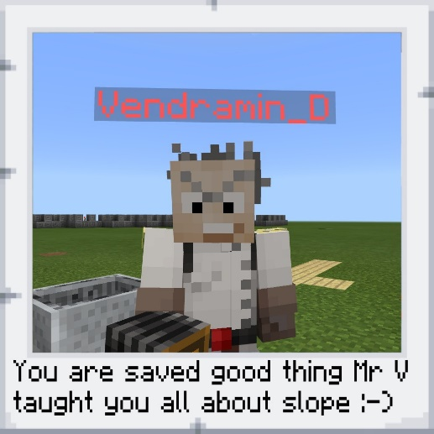
Minecraft In The Math Classroom
Digital Breakout
Fun Way to Engage
Used OneNote
Slope Breakout

Slide 26
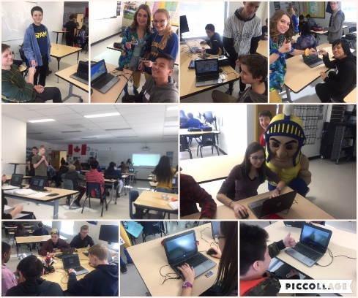
Minecraft In The Math Classroom
Build Battle
Fun Way to Engage
Creativity Counts
Each side is 1m
Get Ready For A Build Battle

Slide 27
Build Battle #1 – Surface Area
You will have 5 minutes to construct an object with a surface area of
25m² (side of each cube is 1m)

Slide 28
Build Battle #2 – Surface Area
You will have 5 minutes to construct an object with a surface area of
50m² (side of each cube is 1m)

Slide 29
Build Battle #3 – Symmetry
You will have 5 minutes to construct an a symmetrical pattern and indicate type or types of symmetry.

Slide 30
Build Battle #4 – Scale
You will have 5 minutes to construct monument of your choice that represents the community you are from (reduction or enlargement)

Slide 31
Minecraft In The Math Classroom
PD Opportunities
#MADPD
Microsoft Innovative Expert -
https://education.microsoft.com
Code for Points - DVOJT2HOTH90FY2017

Slide 32
Minecraft In The Math Classroom
Feedback
Please tell me three take-aways or ideas you got from this presentation
www.menti.com with code 785890

Slide 33
Thank You
Minecraft In The Math Classroom
Dean Vendramin
@vendi55
d.vendramin@rcsd.ca
deanvendramin.weebly.com

